Slide 1
Puzzle
Twin primes are two prime numbers whose difference is two.
For example, 17 and 19 are twin primes.
Puzzle: Prove that for every twin prime with one prime greater
than 6, the number in between the two twin primes is
divisible by 6.
For example, the number between 17 and 19 is 18 which is
divisible by 6.

Slide 2
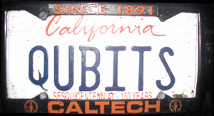
CSEP 590tv: Quantum Computing
Dave Bacon
July 6, 2005
Today’s Menu
Administrivia
Basis
Two Qubits
Deutsch’s Algorithm
Begin Quantum Teleportation?

Slide 3
Administrivia
Hand in Homework #1
Pick up Homework #2
Is anyone not on the mailing list?

Slide 4
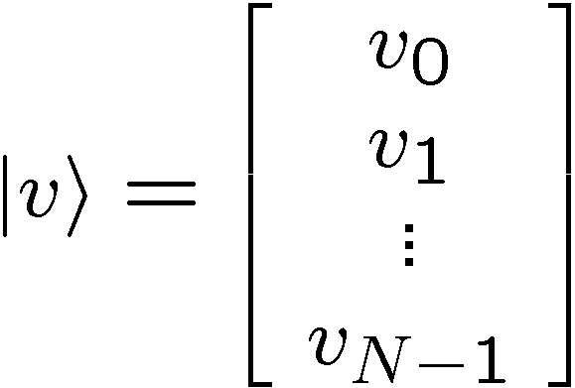
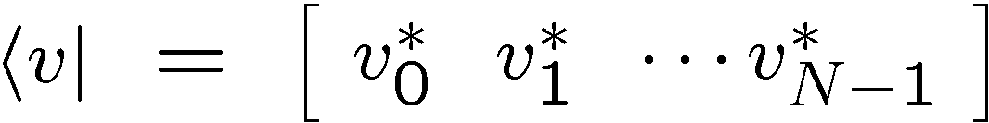
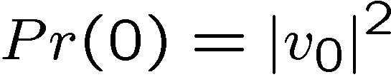
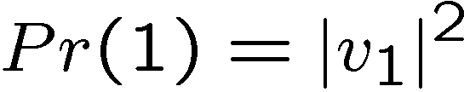
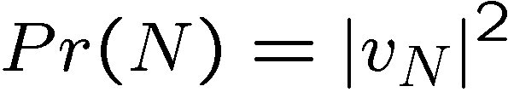
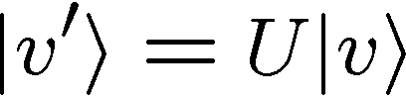

Recap
The description of a quantum system is a complex vector
Measurement in computational basis gives outcome with
probability equal to modulus of component squared.
Evolution between measurements is described by a unitary
matrix.

Slide 5
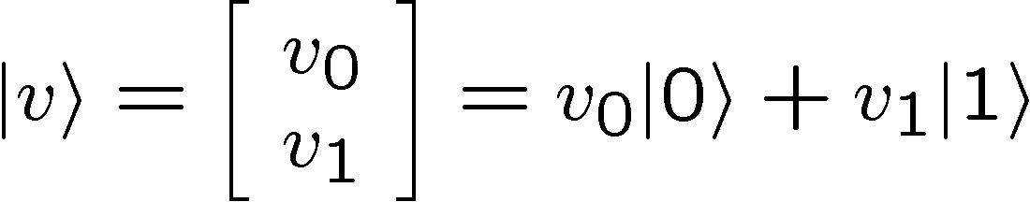
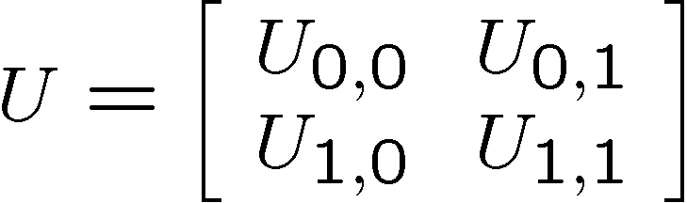
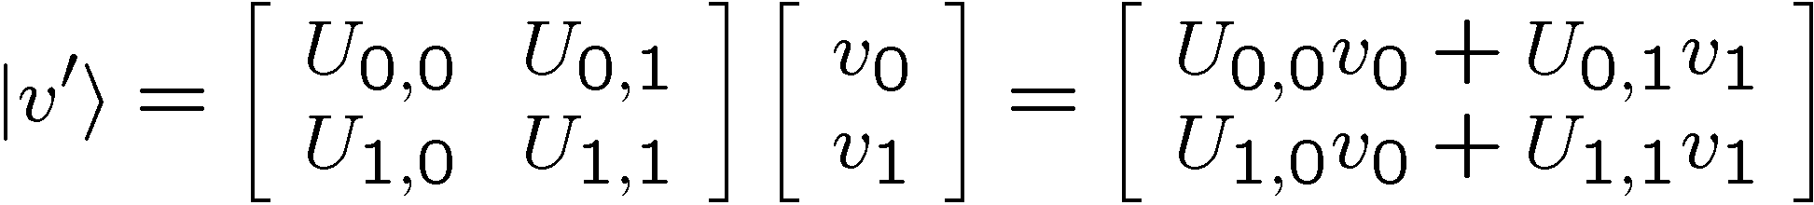
Recap
Qubits:
Measuring a qubit:
Unitary evolution of a qubit:

Slide 6
Goal of This Lecture
Finish off single qubits. Discuss change of basis.
Two qubits. Tensor products.
Deutsch’s Problem
By the end of this lecture you will be ready to embark
on studying quantum protocols….like quantum teleportation

Slide 7



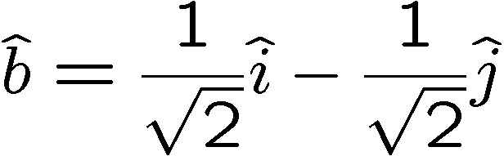
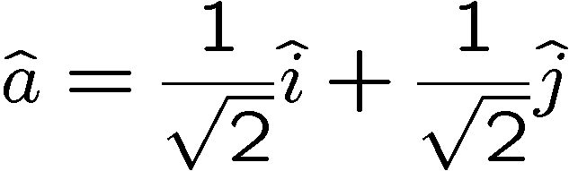
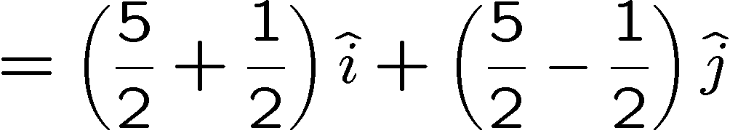
Basis?
“Other coordinate system”

Slide 8








Resolving a Vector
use the dot product to get the component of a vector
along a direction:
unit vector
use two orthogonal unit vectors in 2D to write in new basis:
orthogonal
unit vectors:

Slide 9
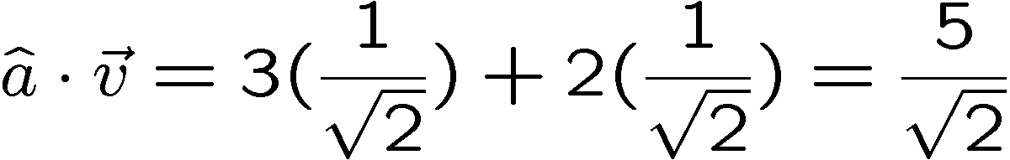
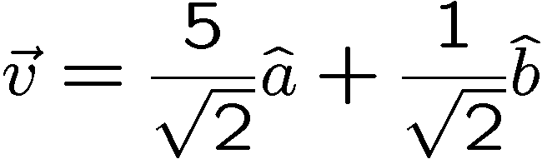
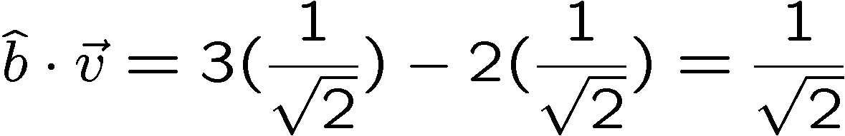
Expressing In a New Basis
“Other coordinate system”

Slide 10

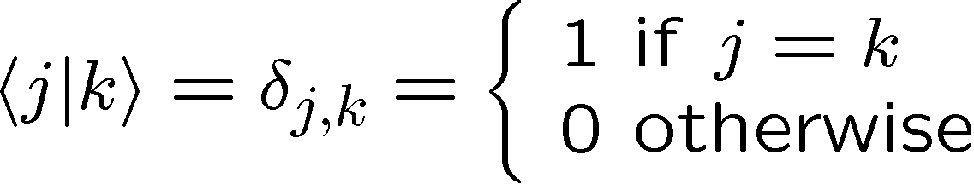


Computational Basis
Computational basis:
is an orthonormal basis:
Kronecker delta
Computational basis is important because when we measure
our quantum computer (a qubit, two qubits, etc.) we get
an outcome corresponding to these basis vectors.
But there are all sorts of other basis which we could use to, say,
expand our vector about.

Slide 11
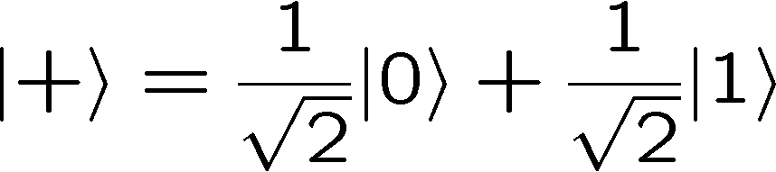
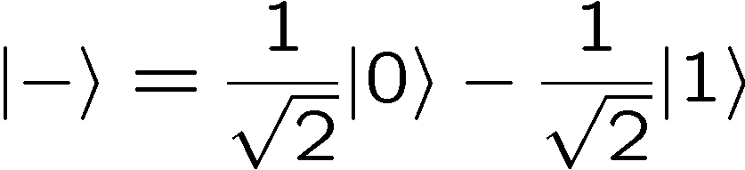
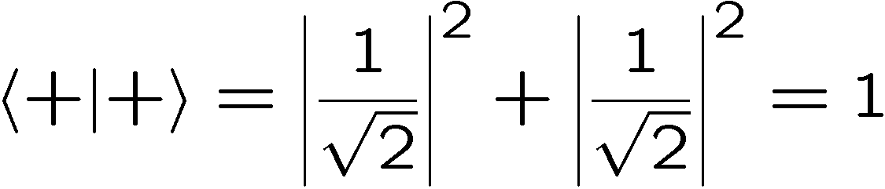
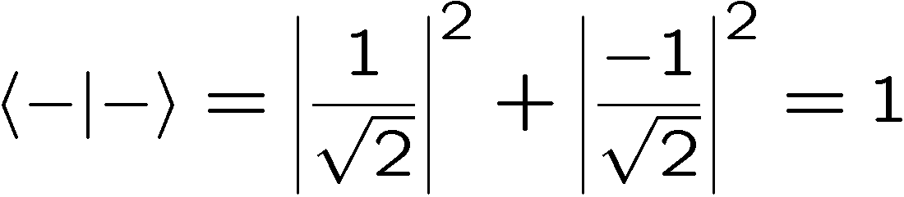
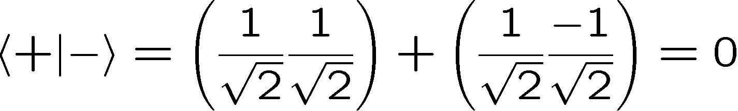
A Different Qubit Basis
A different orthonormal basis:
An orthonormal basis is complete if the number of basis elements
is equal to the dimension of the complex vector space.

Slide 12



Changing Your Basis
Express the qubit wave function
in the orthonormal complete basis
in other words find component of.
Some inner products:
So:
Calculating these inner products allows us to express the
ket in a new basis.

Slide 13

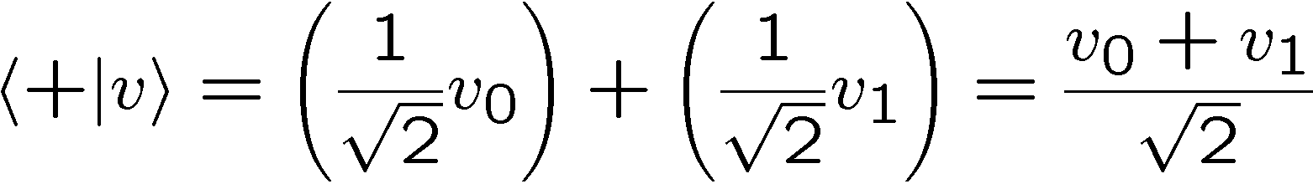
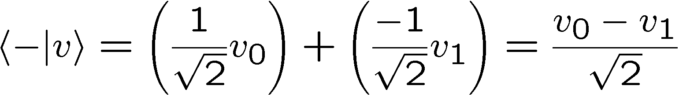
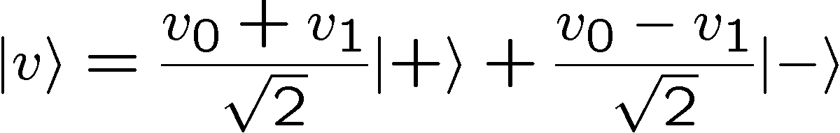
Example Basis Change
Express in this basis:
So:

Slide 14

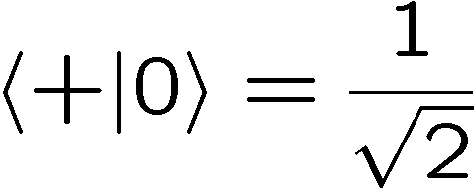
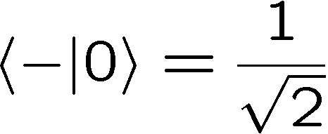
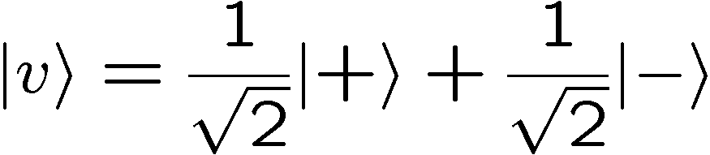
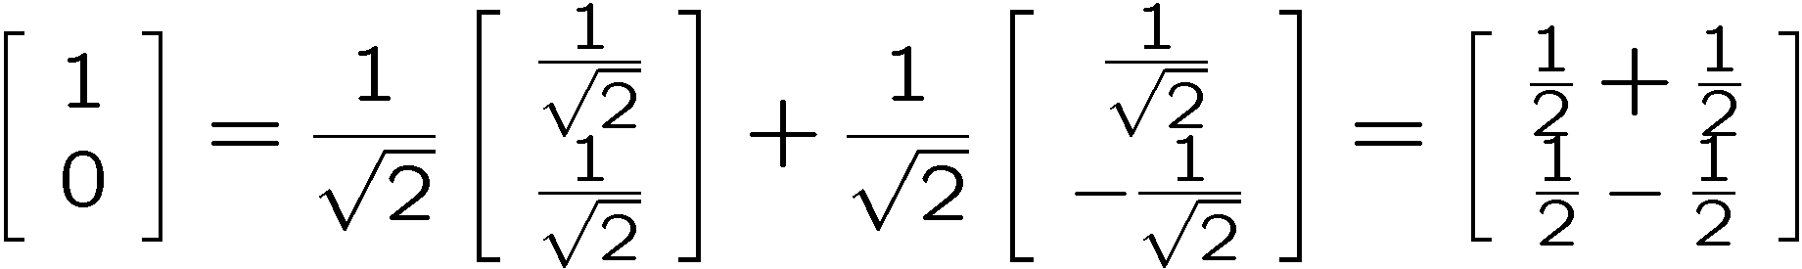
Explicit Basis Change
Express in this basis:
So:

Slide 15
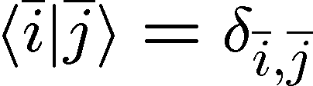
Basis
We can expand any vector in terms of an orthonormal basis:
Why does this matter? Because, as we shall see next,
unitary matrices can be thought of as either rotating a
vector or as a “change of basis.”
To understand this, we first note that unitary matrices have
orthonormal basis already hiding within them…

Slide 16
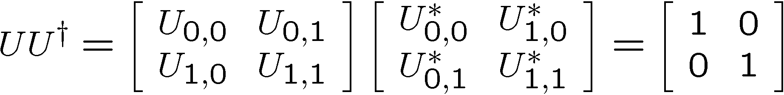
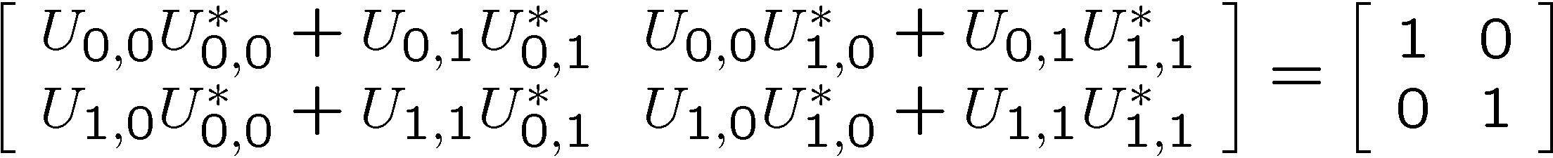
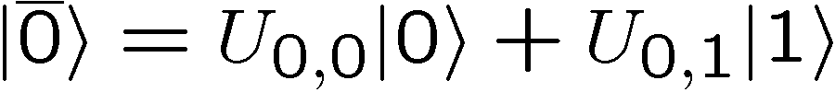
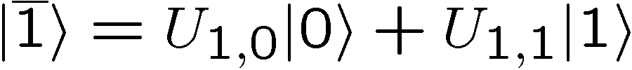
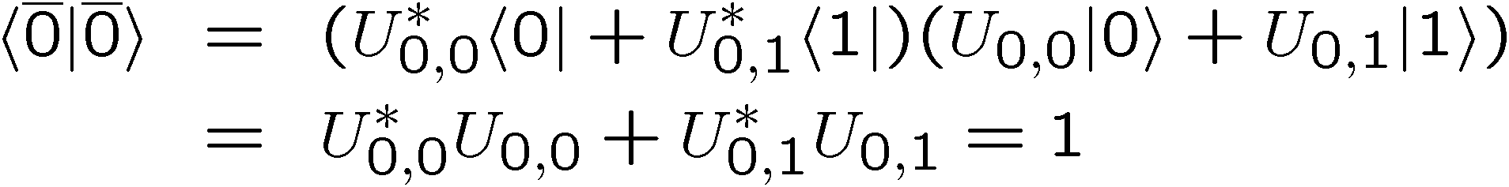
Unitary Matrices, Row Vectors
Four equations:
Say the row vectors, are an orthonormal basis
For example:

Slide 17
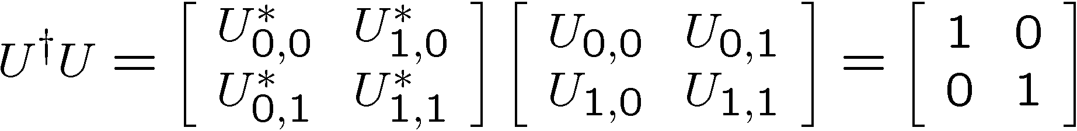
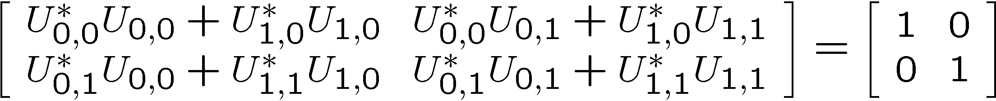
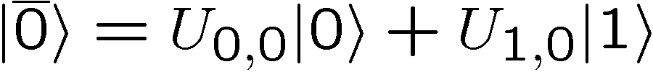
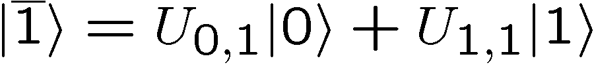

Unitary Matrices, Column Vectors
Four equations:
Say the column vectors, are an orthonormal basis
For example:

Slide 18
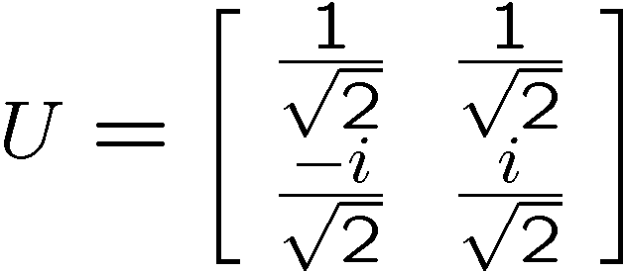
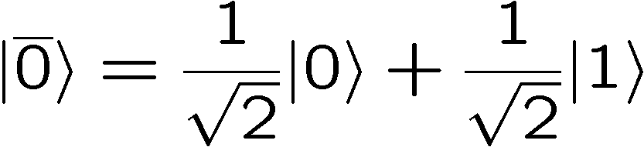
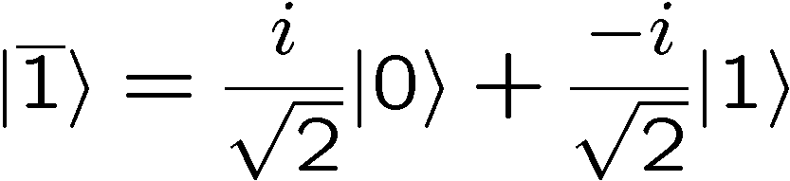
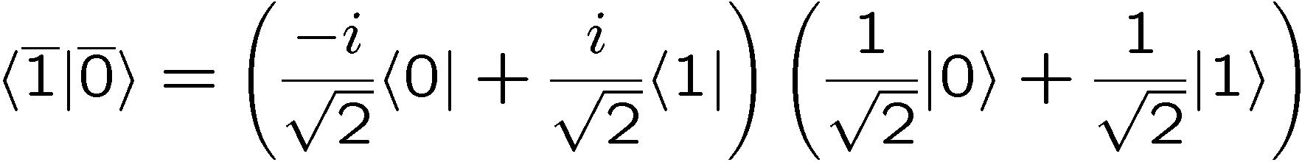
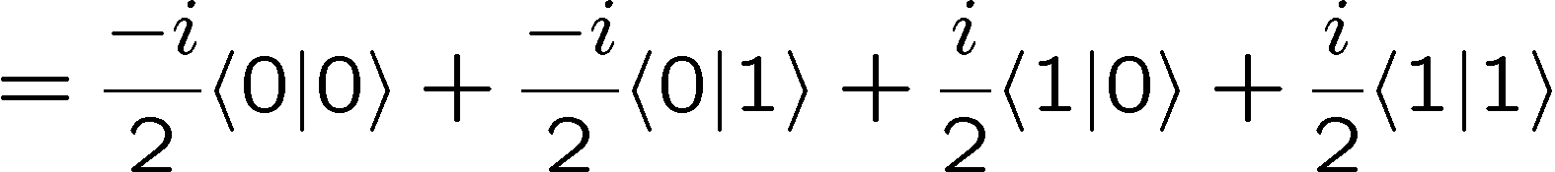
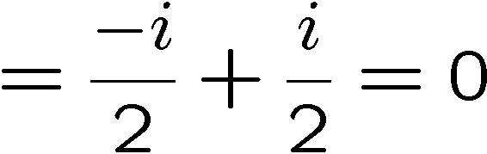
Unitary Matrices, Row & Column
Example:
Row vectors
Are orthogonal

Slide 19


Unitary Matrices as “Rotations”
Unitary matrices represent
“rotations” of the complex
vectors

Slide 20

Unitary Matrices as “Rotations”
Unitary matrices represent
“rotations” of the complex
vectors

Slide 21





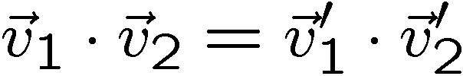
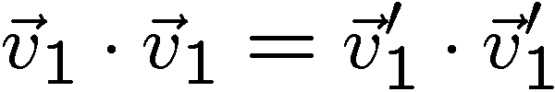
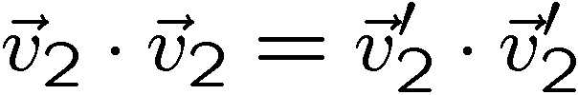
Rotations and Dot Products
Unitary matrices represent “rotations” of the complex vectors
Recall: rotations of real vectors preserve angles between vectors
and preserve lengths of vectors.
rotation
What is the corresponding condition for unitary matrices?

Slide 22
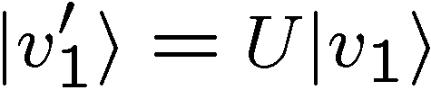
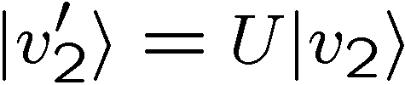
Unitary Matrices, Inner Products
Unitary matrices preserve the inner product of two complex
vectors:
Adjoint-ing rule: reverse order and adjoint elements:
Inner product is preserved:

Slide 23
Unitary Matrices, Backwards
We can also ask what input vectors given computational basis
vectors as their output:
Because of unitarity:

Slide 24






Unitary Matrices, Basis Change
If we express a state
in the row vector basis of
i.e. as
Then the unitary changes this state to
So we can think of unitary matrices as enacting a “basis change”

Slide 25




Measurement Again
Recall that if we measure a qubit in the computational basis,
the probability of the two outcomes 0 and 1 are
We can express is in a different notation, by using
as

Slide 26









Unitary and Measurement
Suppose we perform a unitary evolution followed by a
measurement in the computational basis:
What are the probabilities of the two outcomes, 0 and 1?
which we can express as
Define the new basis
Then we can express the probabilities as

Slide 27




Measurement in a Basis
The unitary transform allows to “perform a measurement in
a basis differing from the computational basis”:
Suppose is a complete basis. Then we can
“perform a measurement in this basis” and obtain outcomes
with probabilities given by:

Slide 28






Measurement in a Basis
Example:

Slide 29
In Class Problem #1

Slide 30

Two Qubits
Two bits can be in one of four different states
00
01
10
11
Similarly two qubits have four different states
00
01
10
11
The wave function for two qubits thus has four components:
first qubit
second qubit
first qubit
second qubit

Slide 31



Two Qubits
Examples:

Slide 32



When Two Qubits Are Two
The wave function for two qubits has four components:
Sometimes we can write the wave function of two qubits
as the “tensor product” of two one qubit wave functions.
“separable”

Slide 33




Two Qubits, Separable
Example:

Slide 34






Two Qubits, Entangled
Example:
Assume:
Either
but this implies
contradictions
or
but this implies
So is not a separable state. It is entangled.

Slide 35








Measuring Two Qubits
If we measure both qubits in the computational basis, then we
get one of four outcomes: 00, 01, 10, and 11
If the wave function for the two qubits is
Probability of 00 is
New wave function is
Probability of 01 is
New wave function is
Probability of 10 is
New wave function is
Probability of 11 is
New wave function is

Slide 36





Two Qubits, Measuring
Example:
Probability of 00 is
Probability of 01 is
Probability of 10 is
Probability of 11 is

Slide 37




Two Qubit Evolutions
Rule 2: The wave function of a N dimensional quantum system
evolves in time according to a unitary matrix . If the wave
function initially is then after the evolution correspond to
the new wave function is

Slide 38


Two Qubit Evolutions

Slide 39
Manipulations of Two Bits
Two bits can be in one of four different states
00
01
10
11
We can manipulate these bits
00
01
01
00
10
10
11
11
Sometimes this can be thought of as just operating on one of
the bits (for example, flip the second bit):
00
01
01
00
10
11
11
10
But sometimes we cannot (as in the first example above)

Slide 40



Manipulations of Two Qubits
Similarly, we can apply unitary operations on only one of the
qubits at a time:
first qubit
second qubit
Unitary operator that acts only on the first qubit:
two dimensional
Identity matrix
two dimensional
unitary matrix
Unitary operator that acts only on the second qubit:

Slide 41





Tensor Product of Matrices

Slide 42




Tensor Product of Matrices
Example:

Slide 43


Tensor Product of Matrices
Example:

Slide 44




Tensor Product of Matrices
Example:

Slide 45
Tensor Product of Matrices
Example:

Slide 46







Two Qubit Quantum Circuits
A two qubit unitary gate
Sometimes the input our output is known to be seperable:
Sometimes we act only one qubit

Slide 47






Some Two Qubit Gates
control
controlled-NOT
target
Conditional on the first bit, the gate flips the second bit.

Slide 48

Computational Basis and Unitaries
Notice that by examining the unitary evolution of all computational
basis states, we can explicitly determine what the unitary matrix.

Slide 49
Linearity
We can act on each computational basis state and then resum
This simplifies calculations considerably

Slide 50




Linearity
Example:

Slide 51




Linearity
Example:

Slide 52






Some Two Qubit Gates
control
controlled-NOT
target
control
controlled-U
target
controlled-phase
swap

Slide 53










Quantum Circuits
controlled-H
Probability of 10:
Probability of 11:
Probability of 00 and 01:

Slide 54
In Class Problem #2

